Slide 1
Study mates matching system
Dream Explorers

Slide 2
Background
Many college students are alone studying, they want to find study mates.
It’s quite hard for us to find study mates that have the same study goal.
Be useful for students who want to find study mates that share the same study goal.
Use matching algorithm to help users find their best study mates.

Slide 3
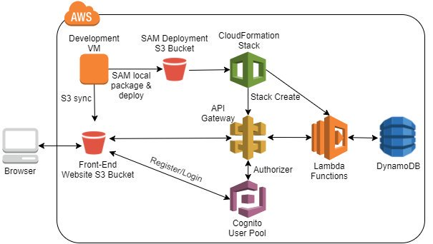
Framework

Slide 4
Tech Stack
Back-end: Lambda Function, Cognito, DynamoDB, SNS, S3, CloudWatch
Front-end: ReactJS + SCSS
API: matching, rating

Slide 5



Slide 6
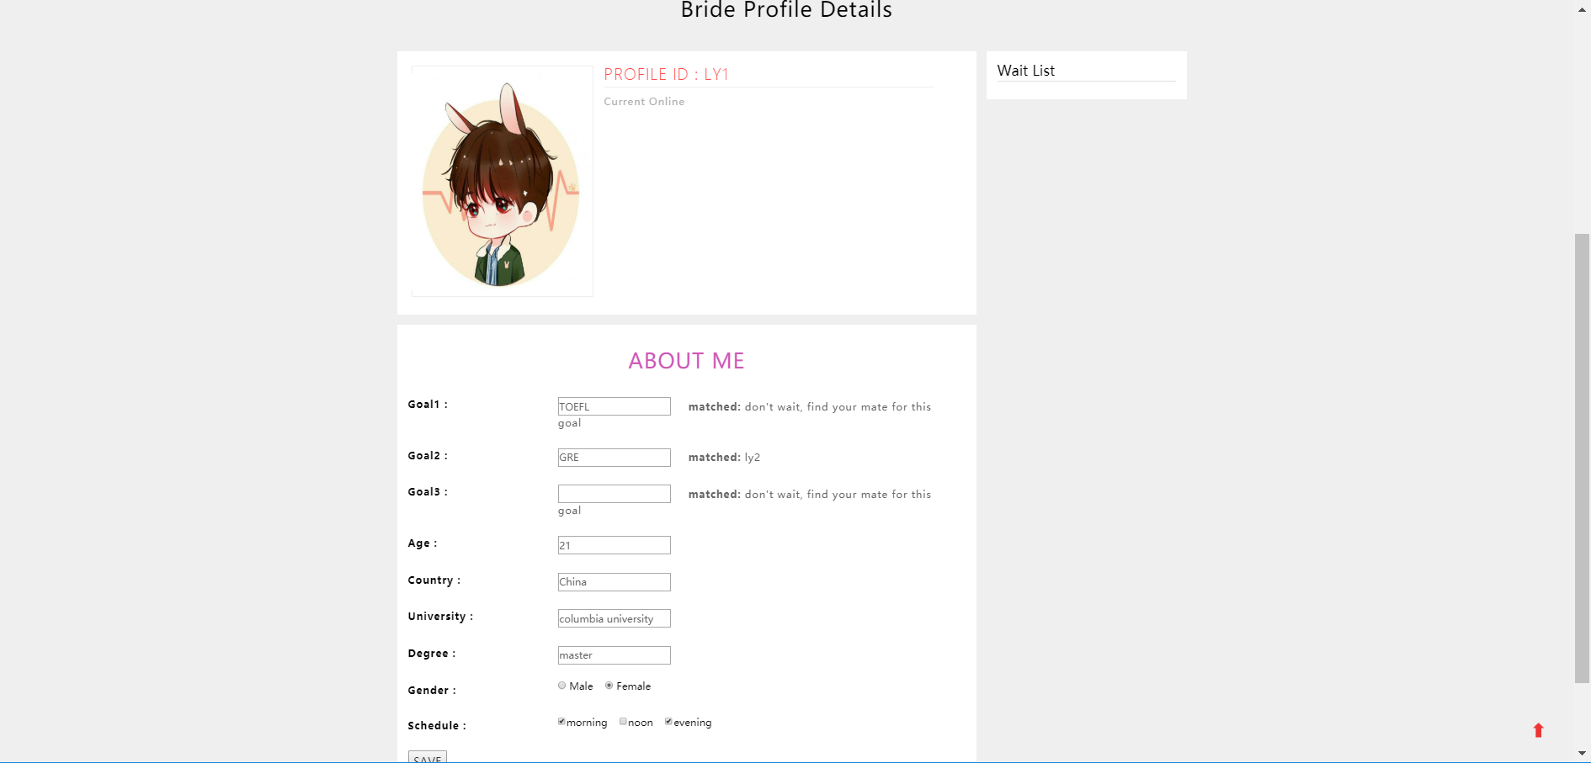

Slide 7
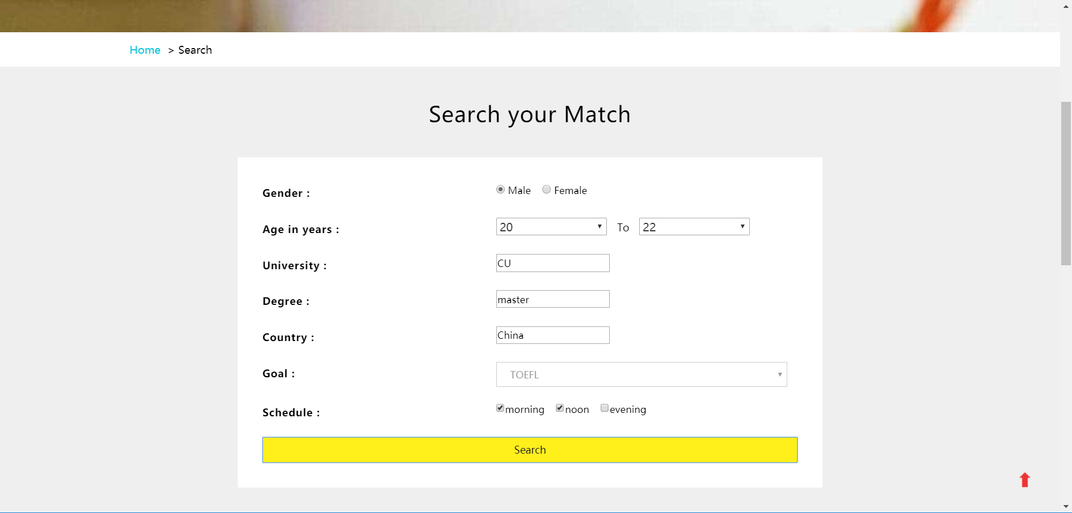

Slide 8
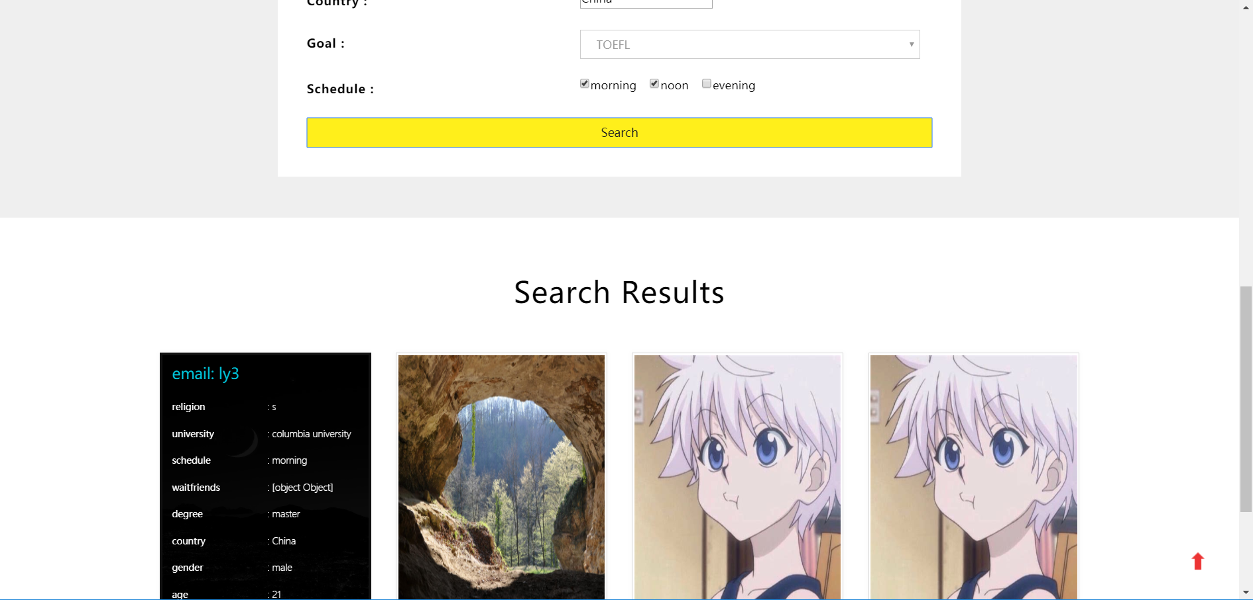

Slide 9
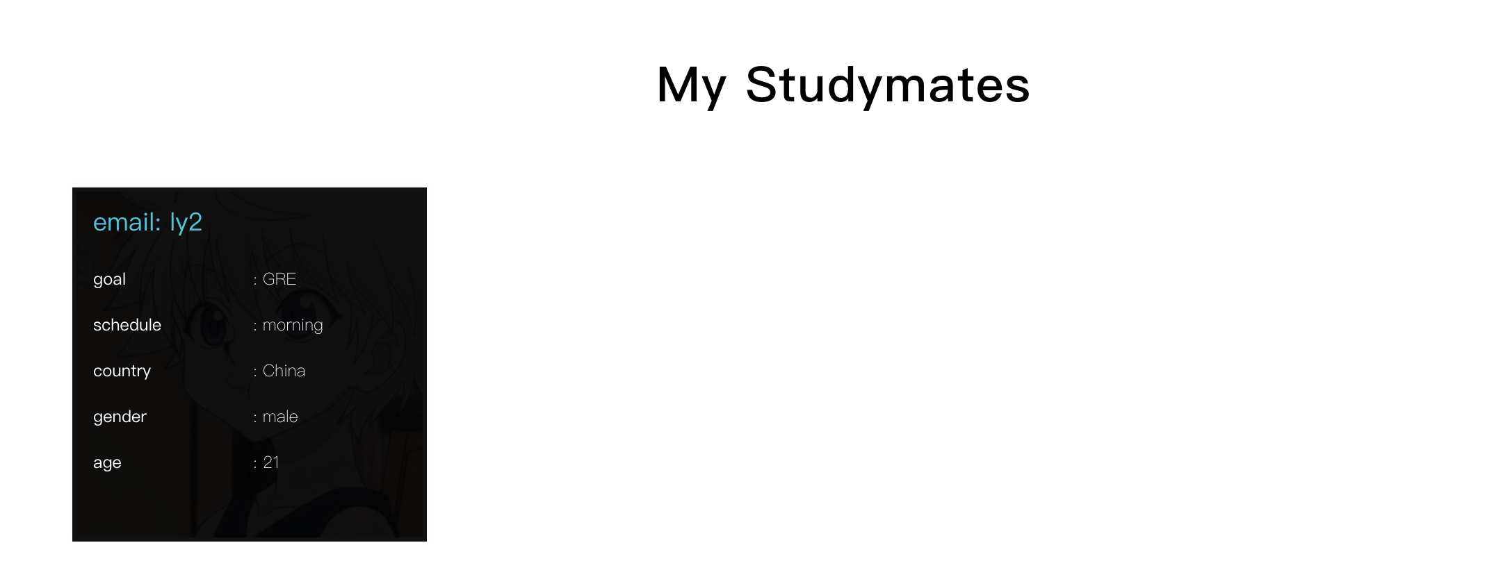

Slide 10
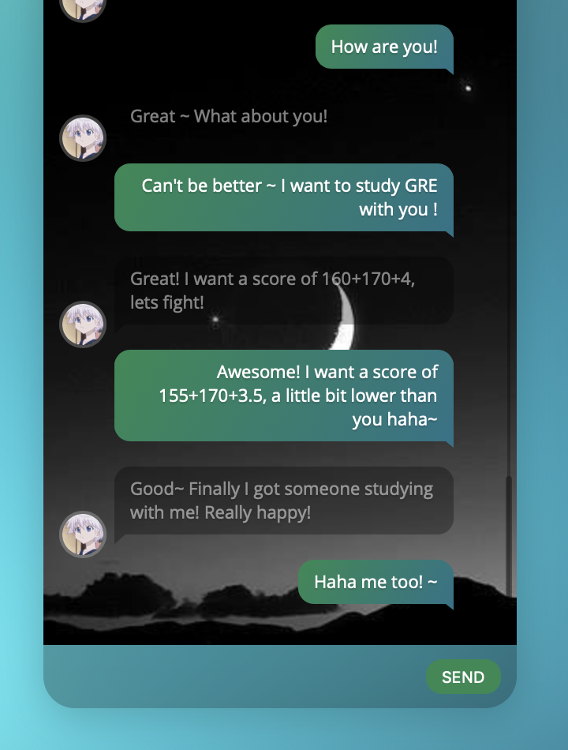
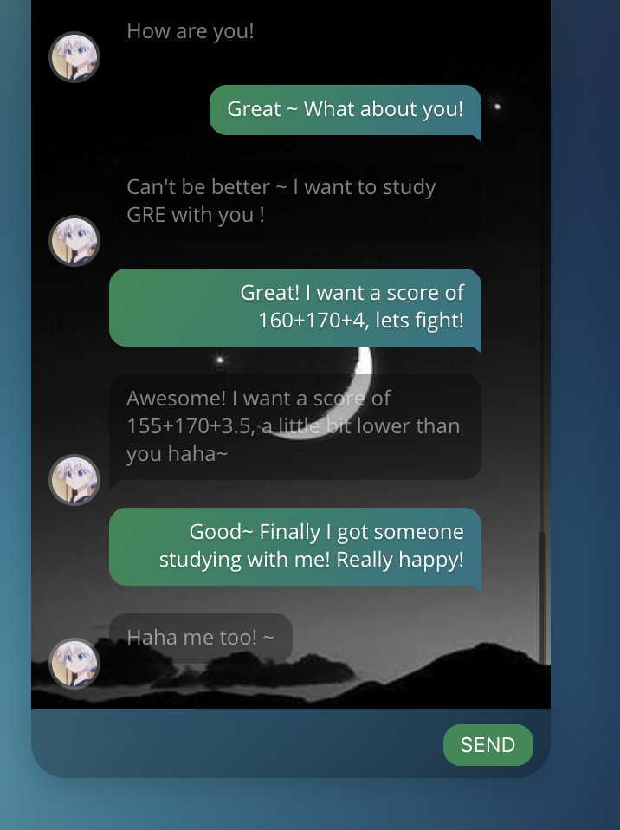

Slide 11
Thank you!

